Slide 1


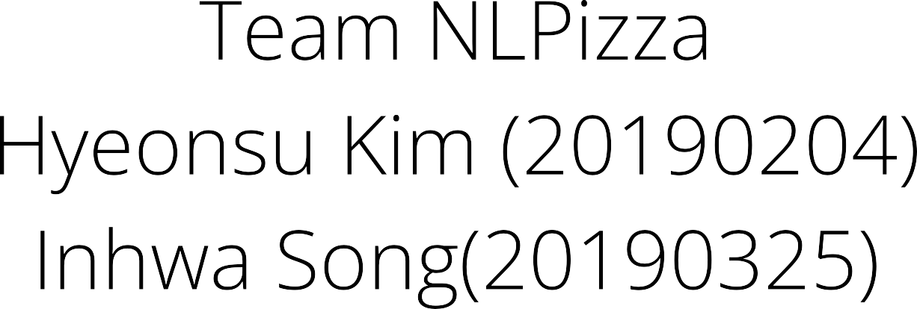


Slide 2


Notes:
Writing diary is an excellent practice that help us reflect our thoughts, and recognize our emotions and experiences. However, in the hustle and bustle of daily life, analyzing diary entries require to much time and effort.

Slide 3
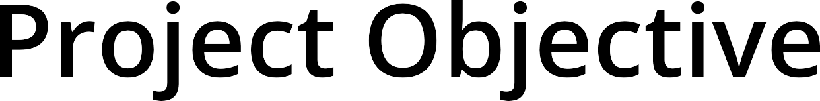
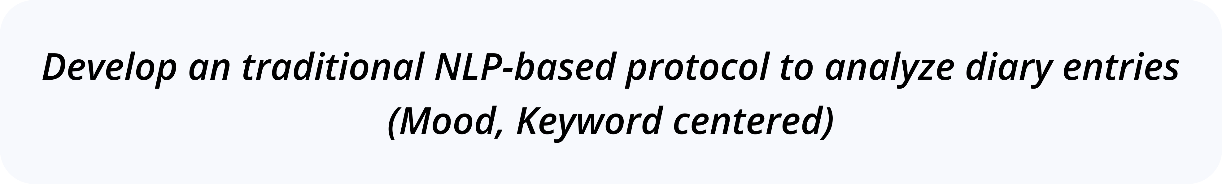

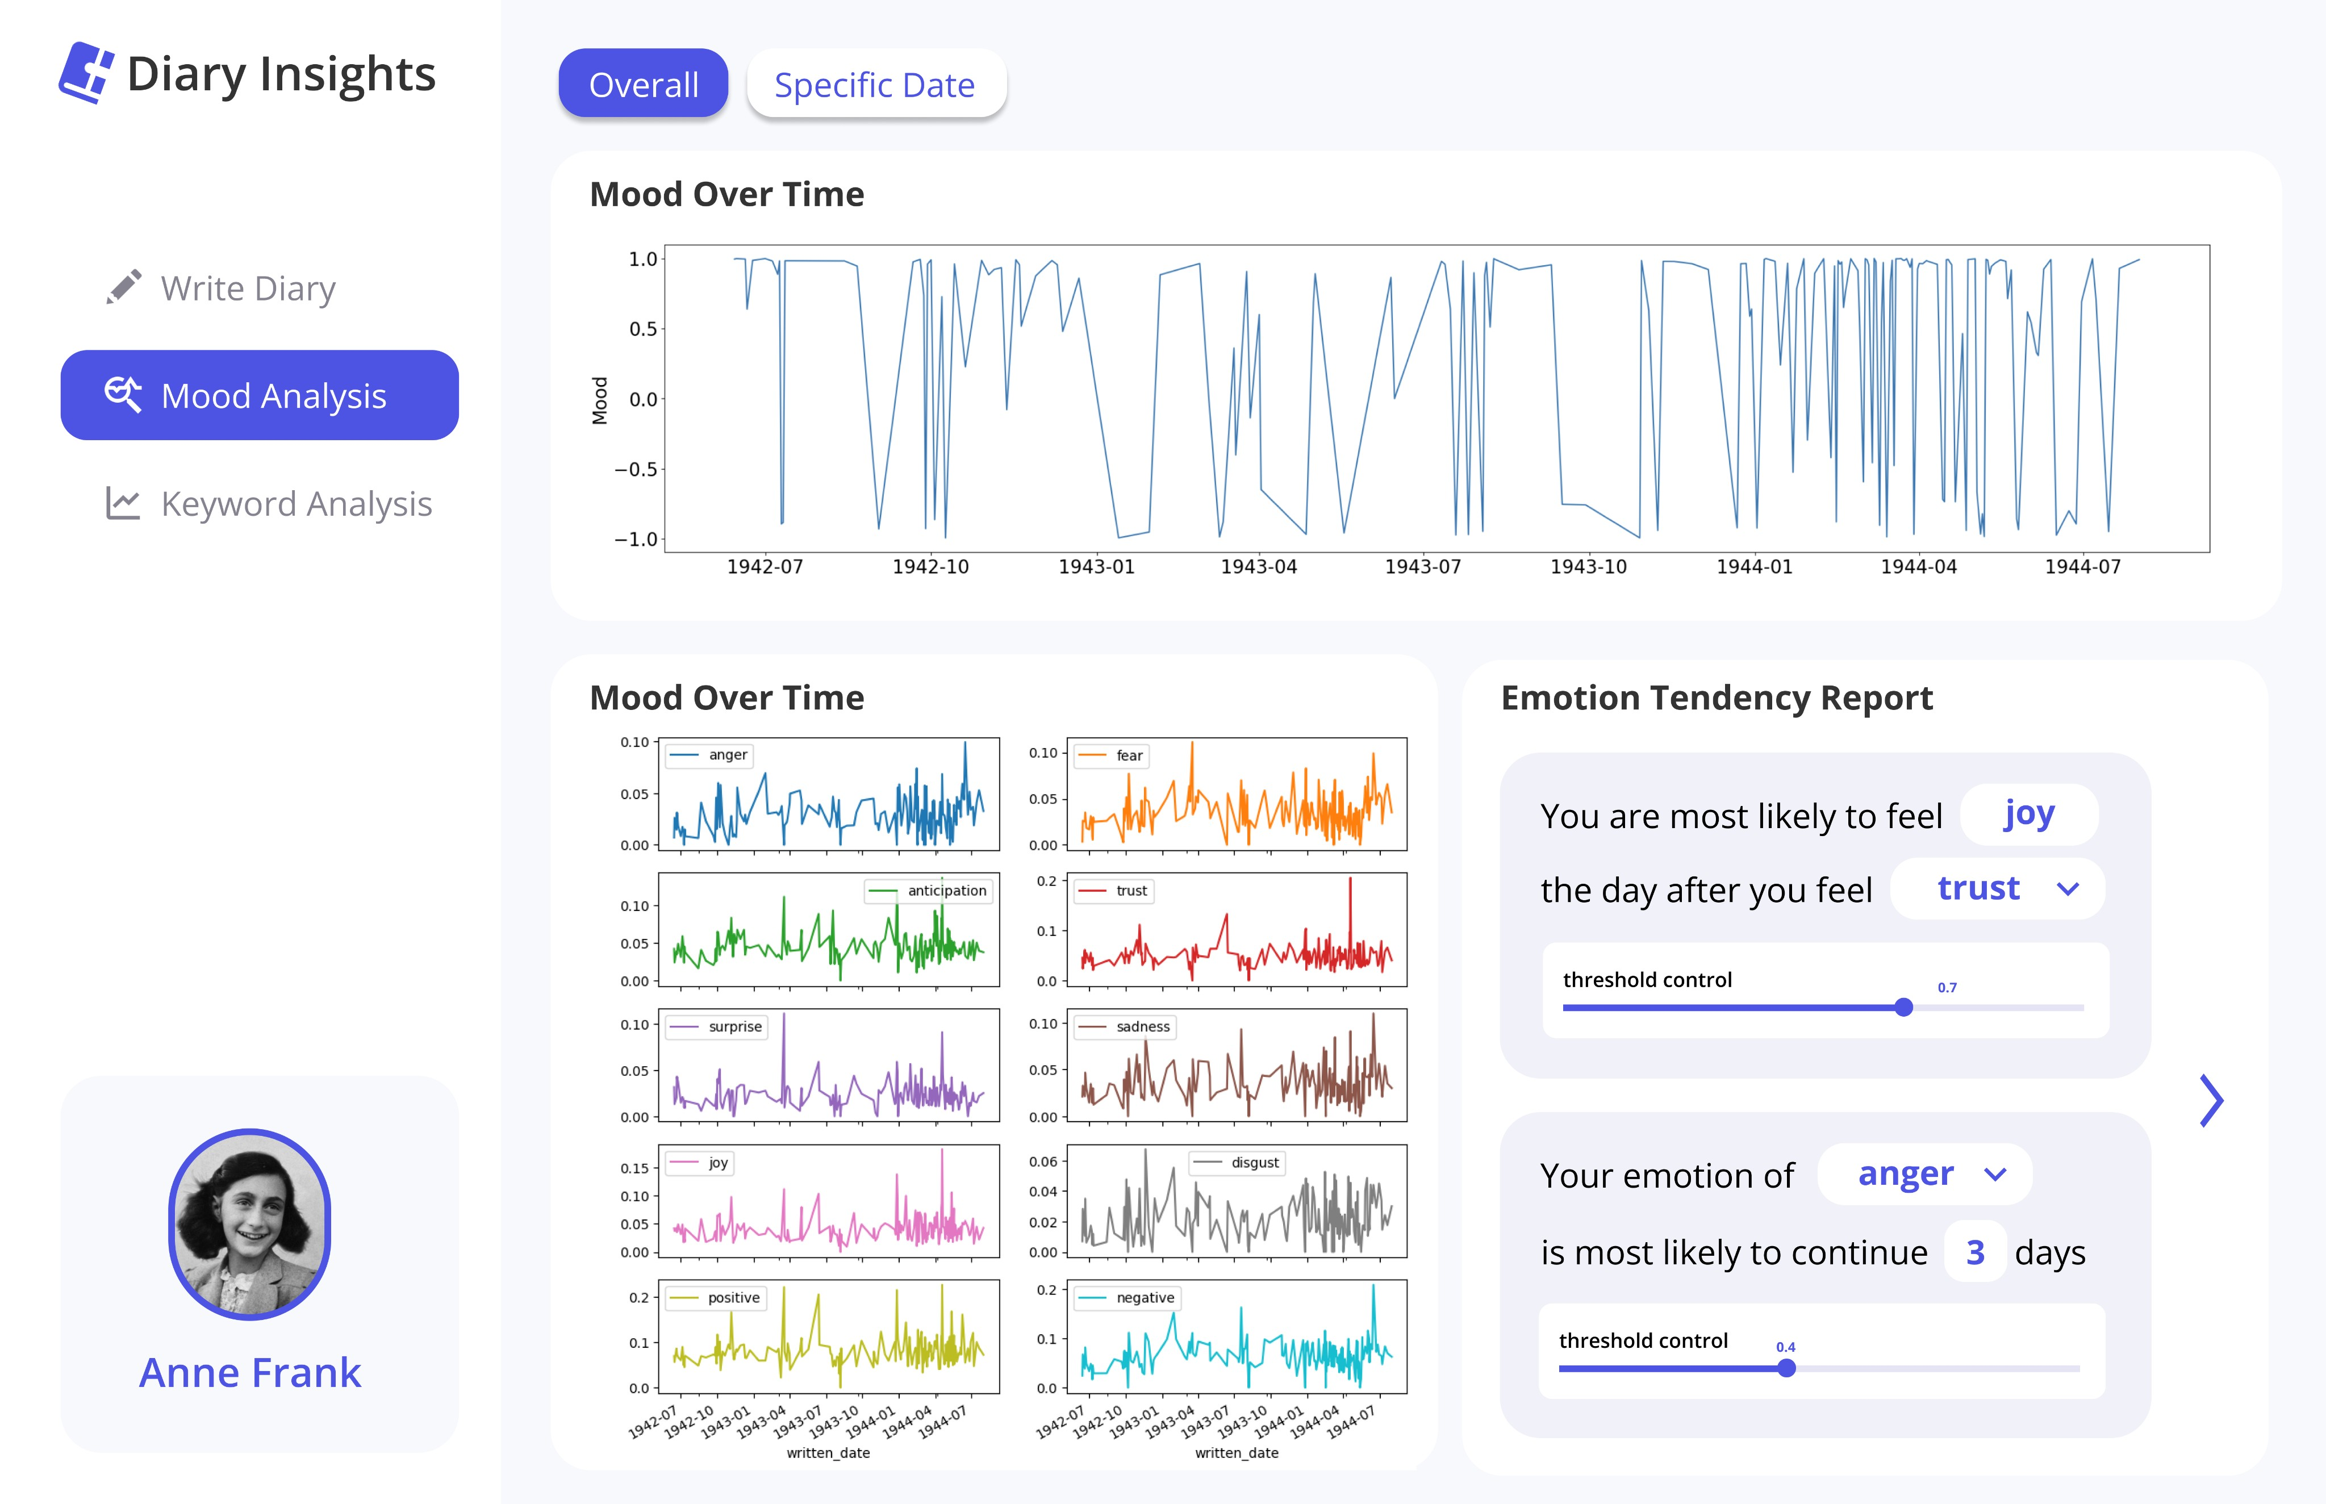
Notes:
we developed an NLP-based system that can analyze and summarize diary entries.

Slide 4


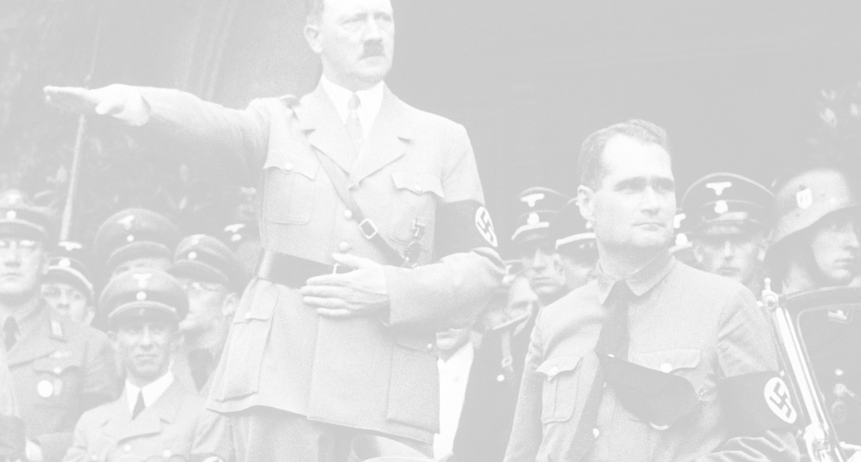
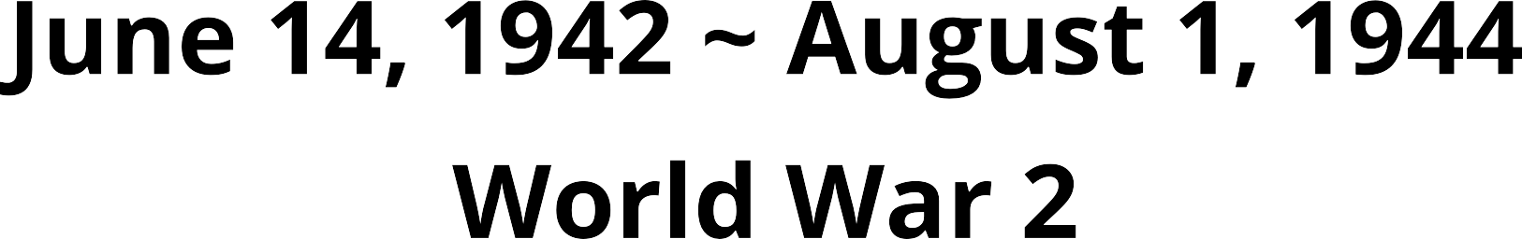
Notes:
We used 2 kind of dataset. First is Anne Frank’s diary which is one that a young girl wrote during world war 2. We actually bought e-book in the google book store.

Slide 5



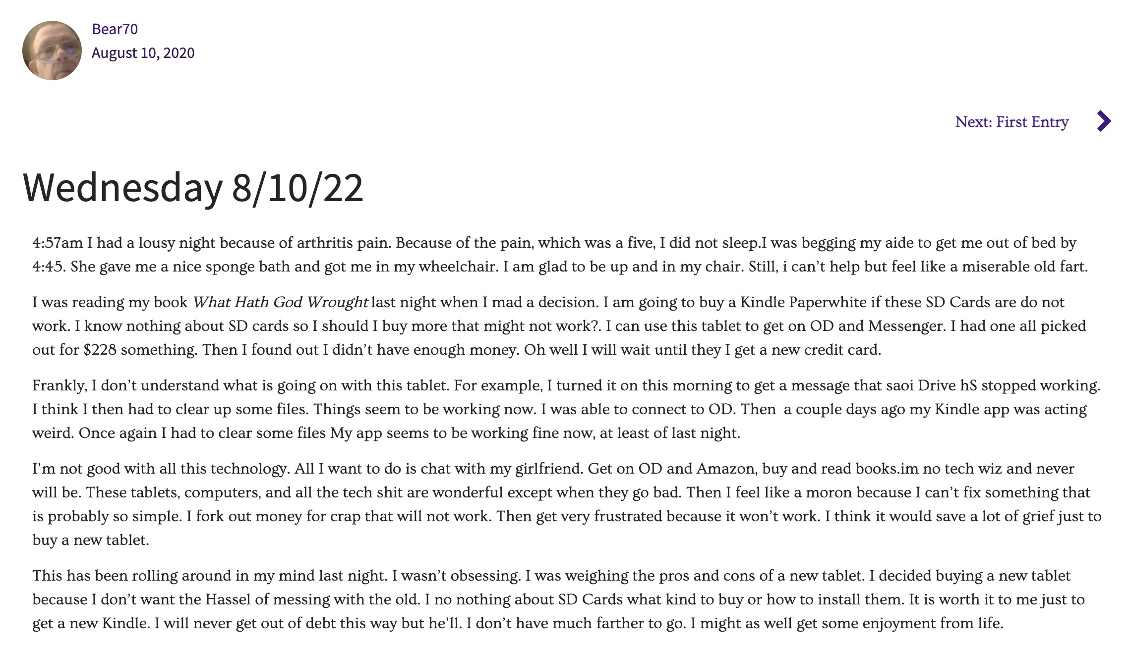
Notes:
Open diary is an online platform. It provides a space where individuals can record their diaries

Slide 6

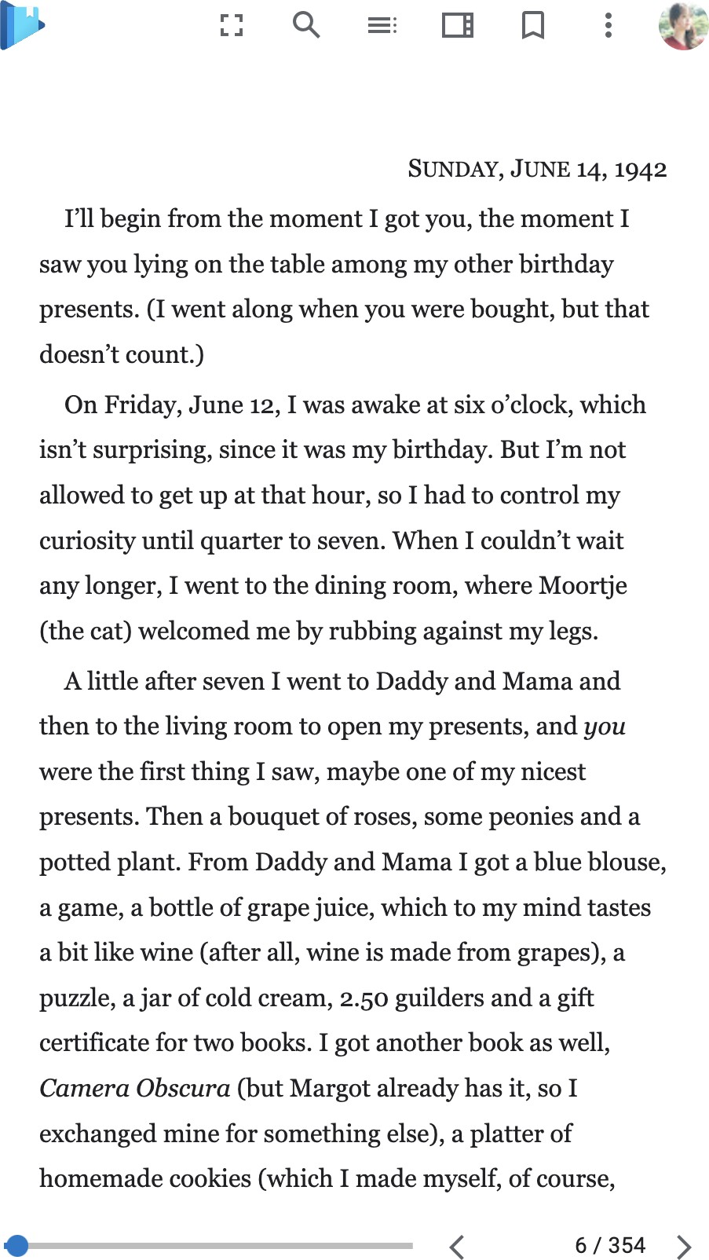
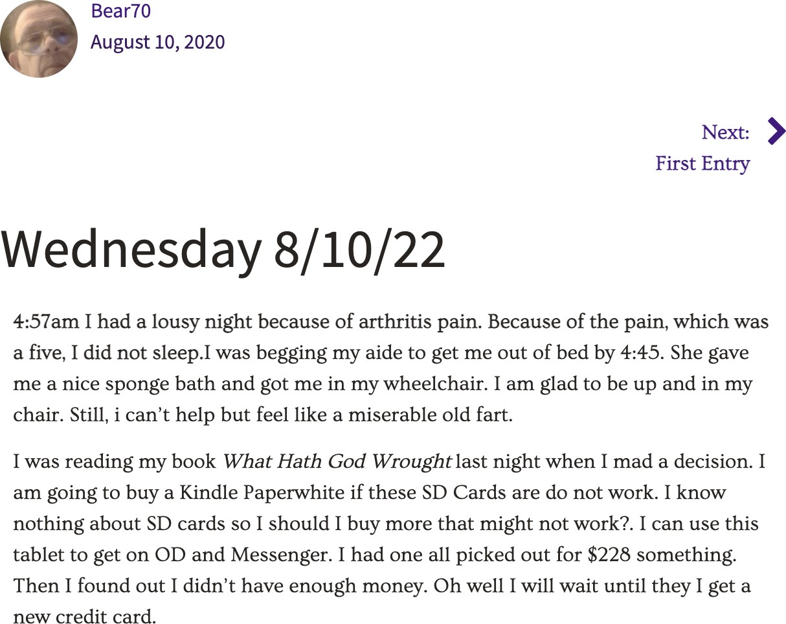
Notes:
Using data from online, we've automated all the data collection in Python. The program extracts the diary of the page by person and save it as a csv file. We used Selenium and Beautiful Soup libraries to implement it.

Slide 7






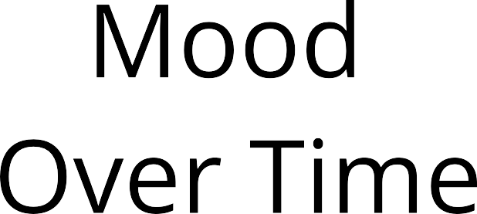
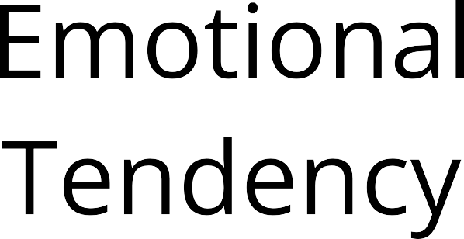
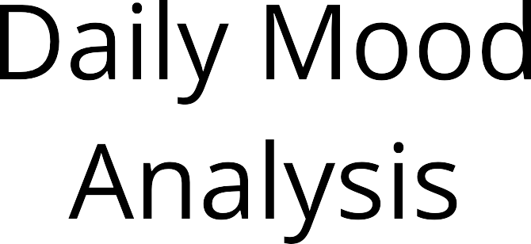
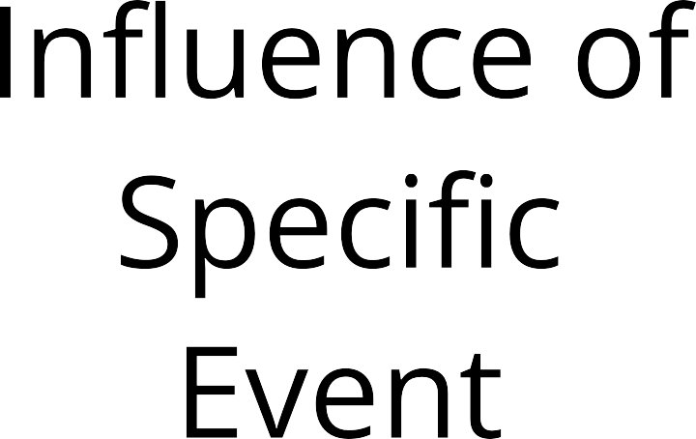
Notes:
We made various approaches for mood analysis in order to gain meaningful insights. Let me explain these step by step

Slide 8

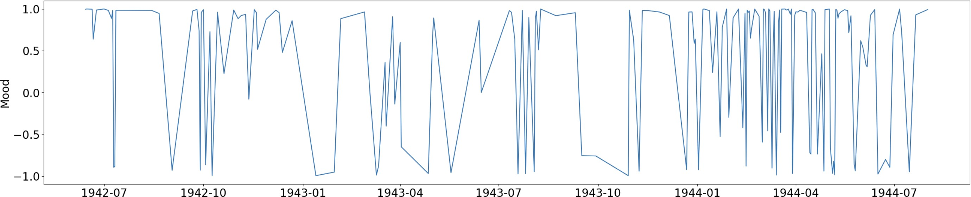
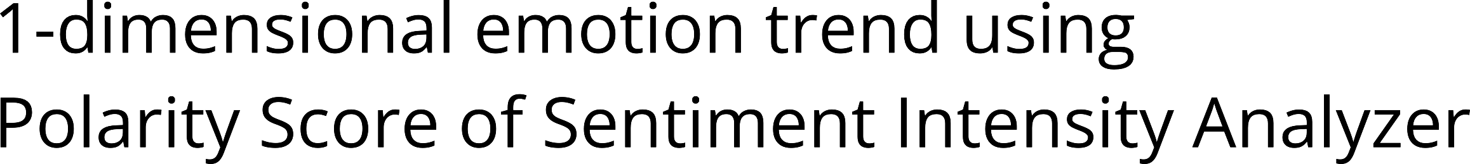
Notes:
In order to visualize the trend of the emotion status in a glance, we used 1 dimensional emotion trend using Polarity Score of Sentiment Intensity Analyzer.

Slide 9
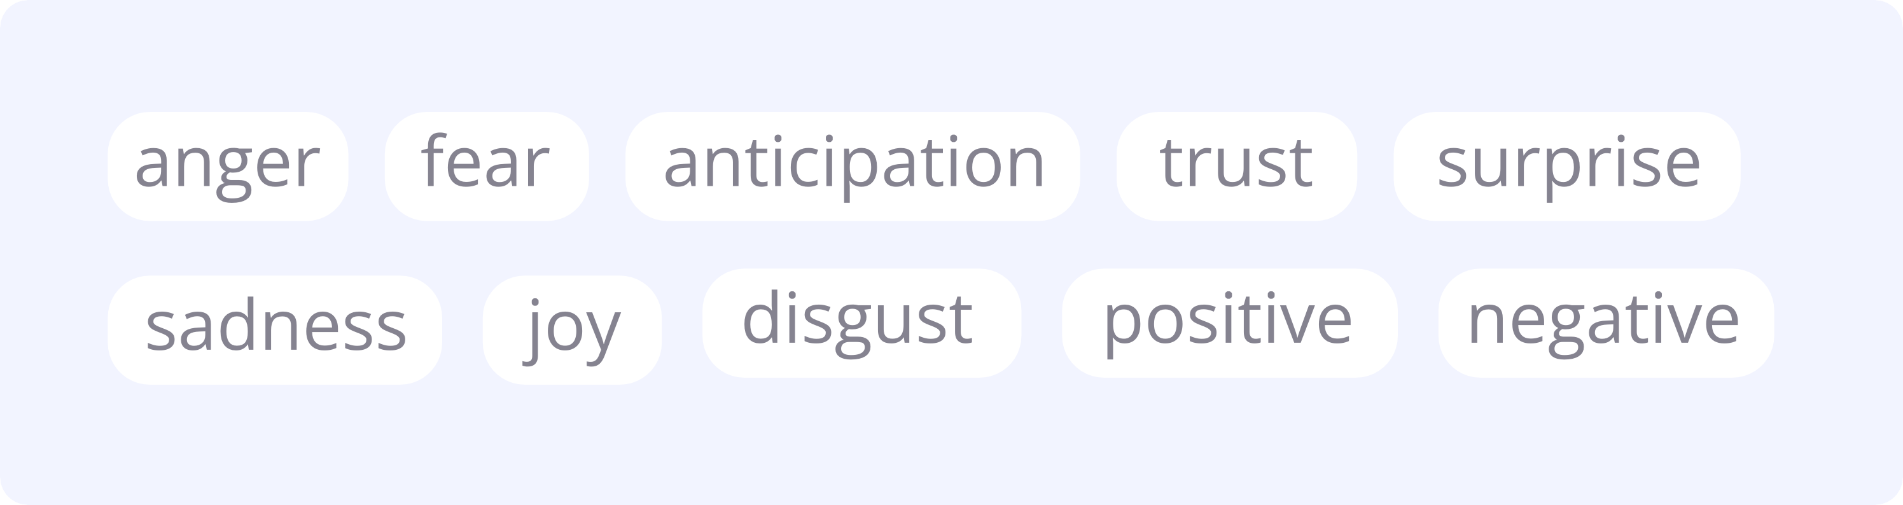
Notes:
However, we not only used 1 dimensional sentimental score, but applied abundant emotion types.

Slide 10
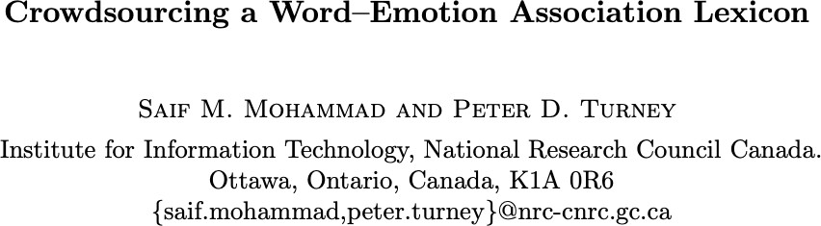
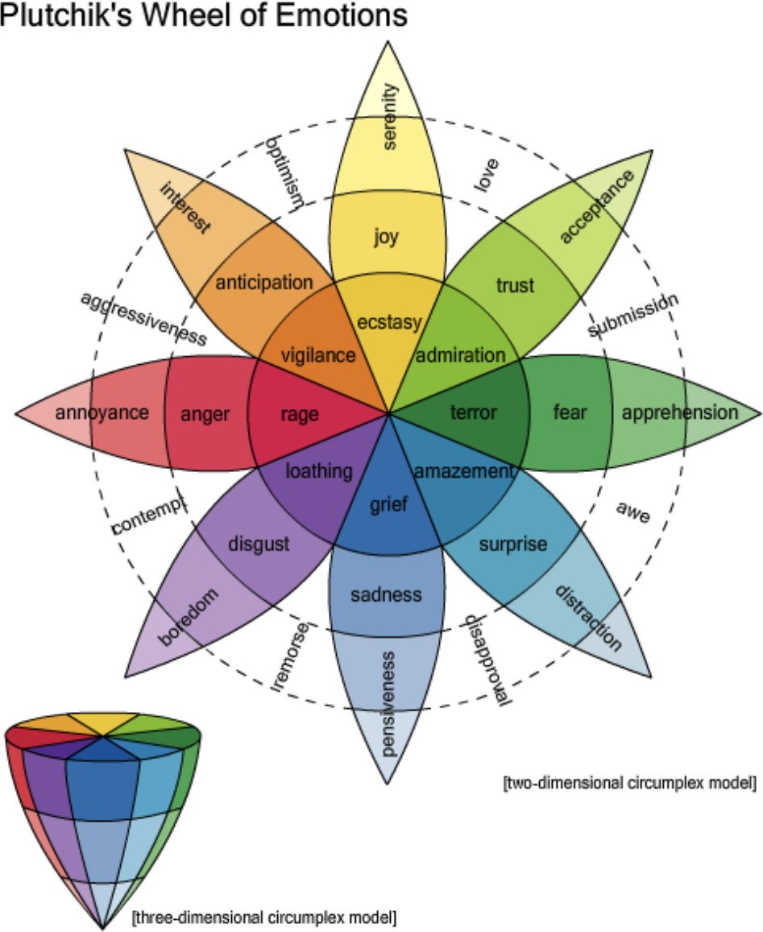

Notes:
For this, we applied a crowdsourced NRC Word-Emotion Association Lexicon which is opened for education and research

Slide 11
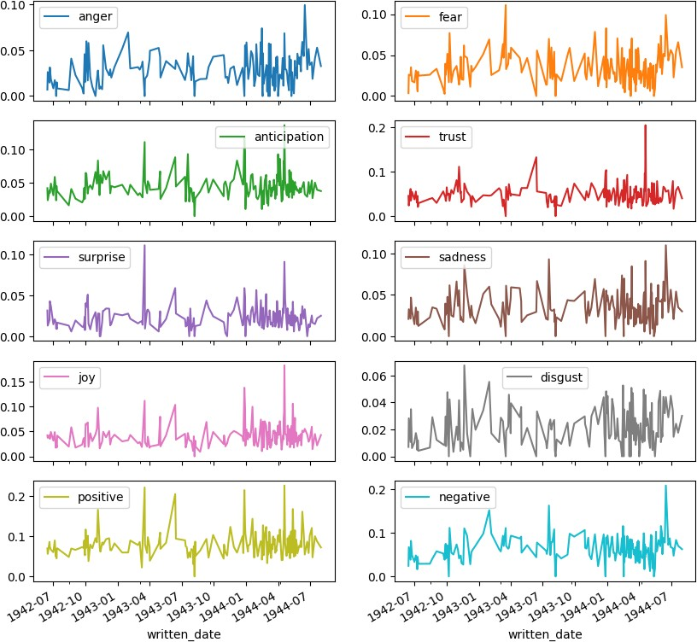
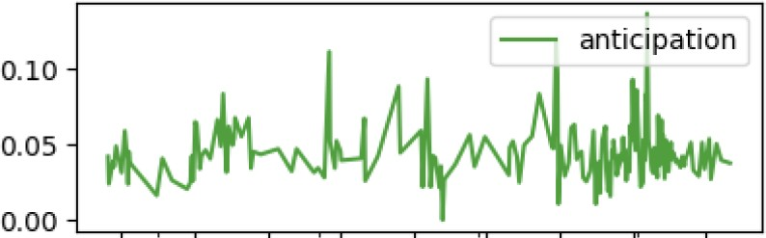
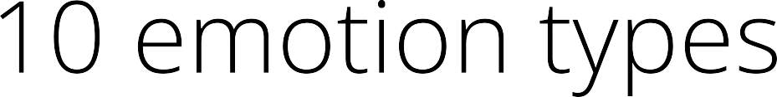
Notes:
We also analyzed the trend of 10 emotion types across the overall time

Slide 12
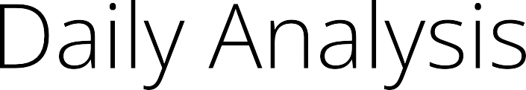
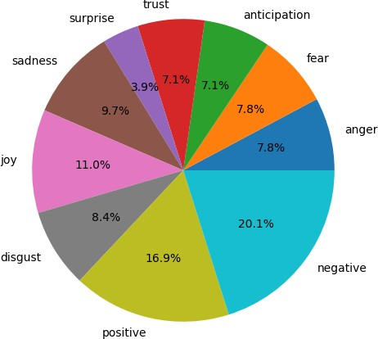
Notes:
Next approach is daily analysis Based on proportion of words mapped to certain emotion, we provide mood ratio of the day

Slide 13
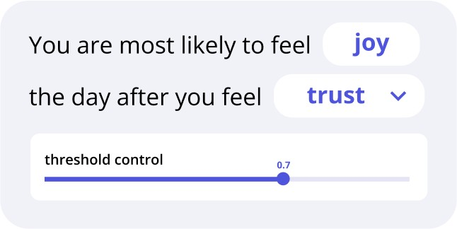
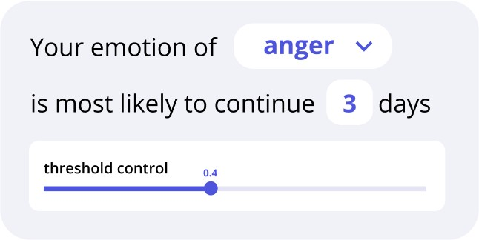
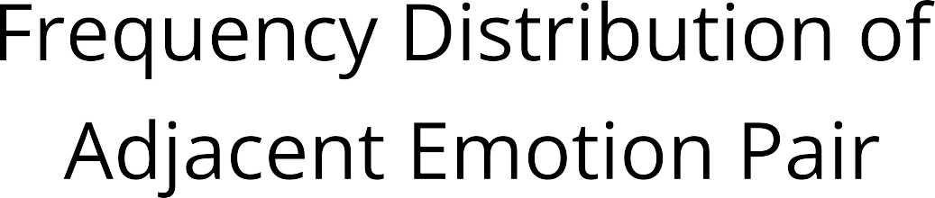
Notes:
We also provide users emotional tendency report. Aren’t you curious how you are likely to feel the next day after you feel certain emotion? Or how much it is likely for some emotion to last? We provide such analysis by investigating fdist of adjacent emotion pair and freq of emotion continuity

Slide 14
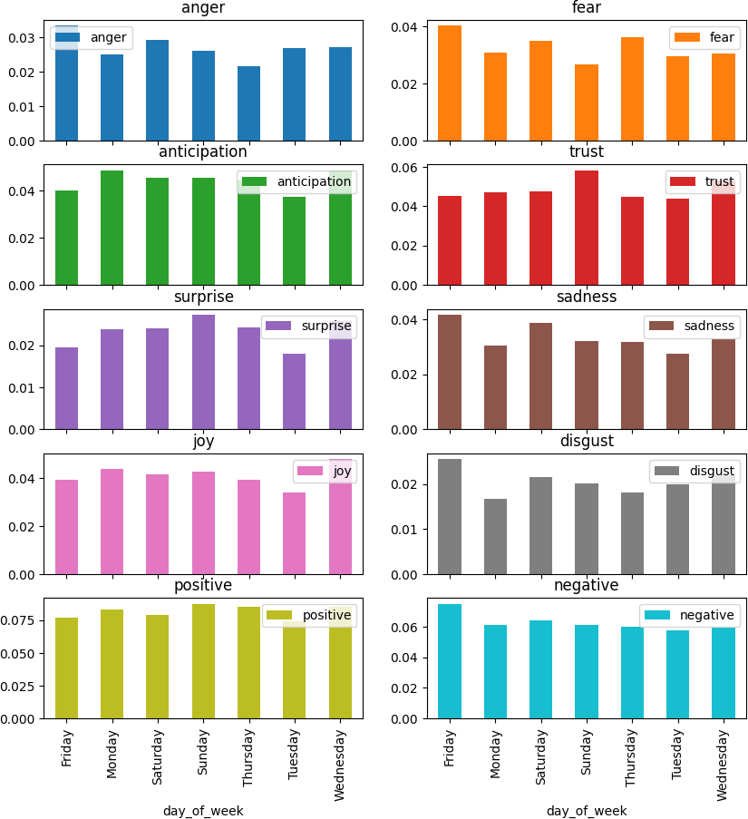
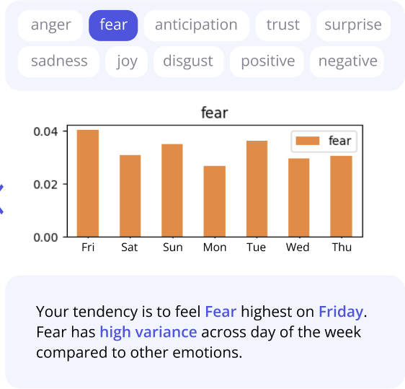
Notes:
Another thing that we provide in emotional tendency report is Your emotion across the week. Which emotion are you most likely to feel the strongest on Monday? Joy from starting the new week? Or Sadness missing your sweet weekend?

Slide 15
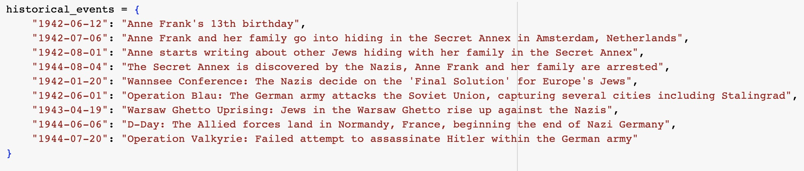
Notes:
We also provide insights how specific event influences your emotion. Especially for Anne Frank, we can see how important historical events regarding World War2 such as German army attacking the Soviet Union influenced a young girl in terms of emotion in a sophisticated manner.

Slide 16
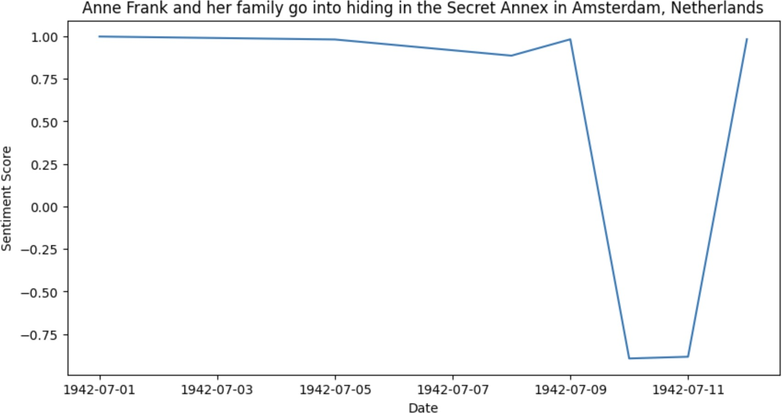
Notes:
And this is one example. A day Anne Frank ~.

Slide 17
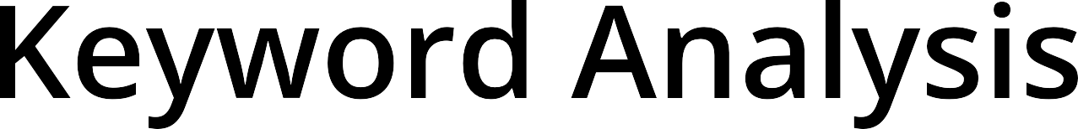
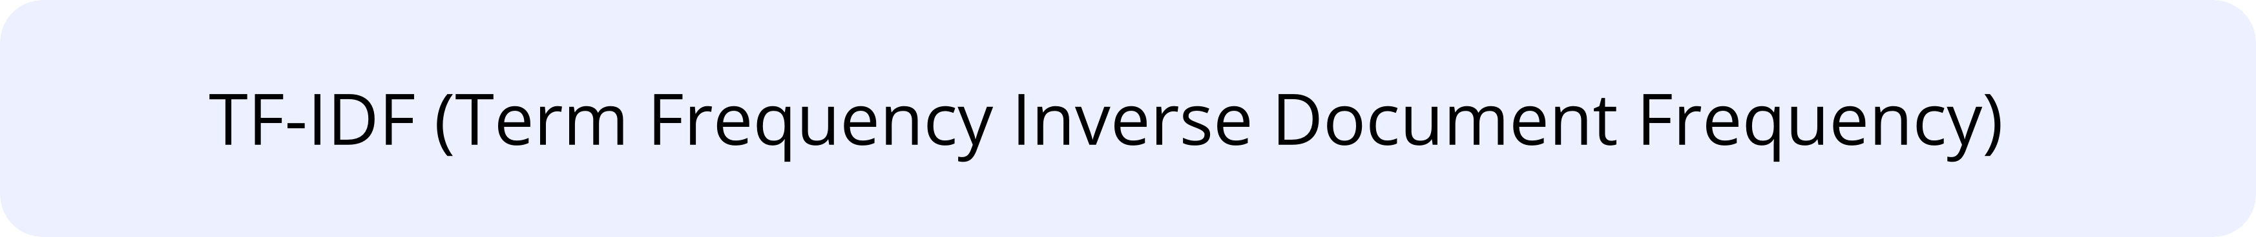
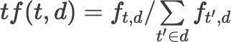
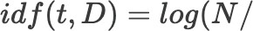
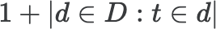
Notes:
There are various methods for keyword analysis, but we focused on the non-Machine-Learning approach. TF-IDF indicates the importance of a word in a document by taking into account its frequency within the document and its rarity across the entire document collection. The product of TF and IDF is the word's importance in the document.

Slide 18
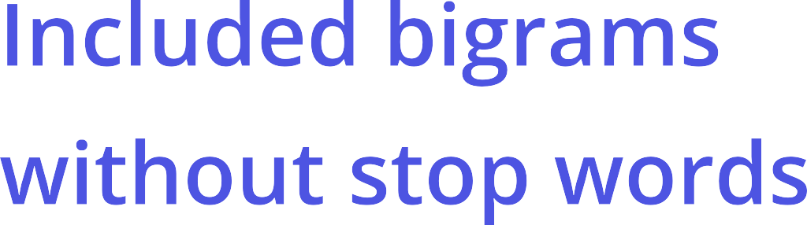
Notes:
To improve performance, we adjusted tf-idf formulas and included bigrams without stop words

Slide 19

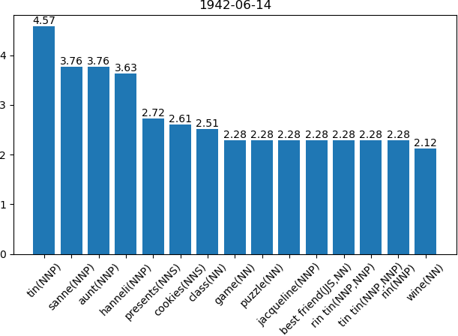
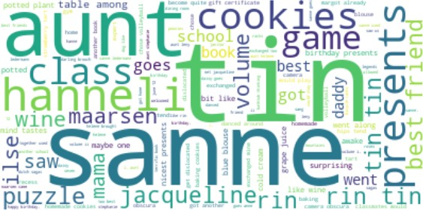

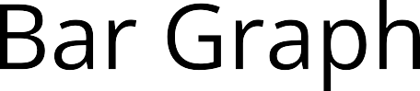
Notes:
These are visualization outputs of keyword analysis

Slide 20

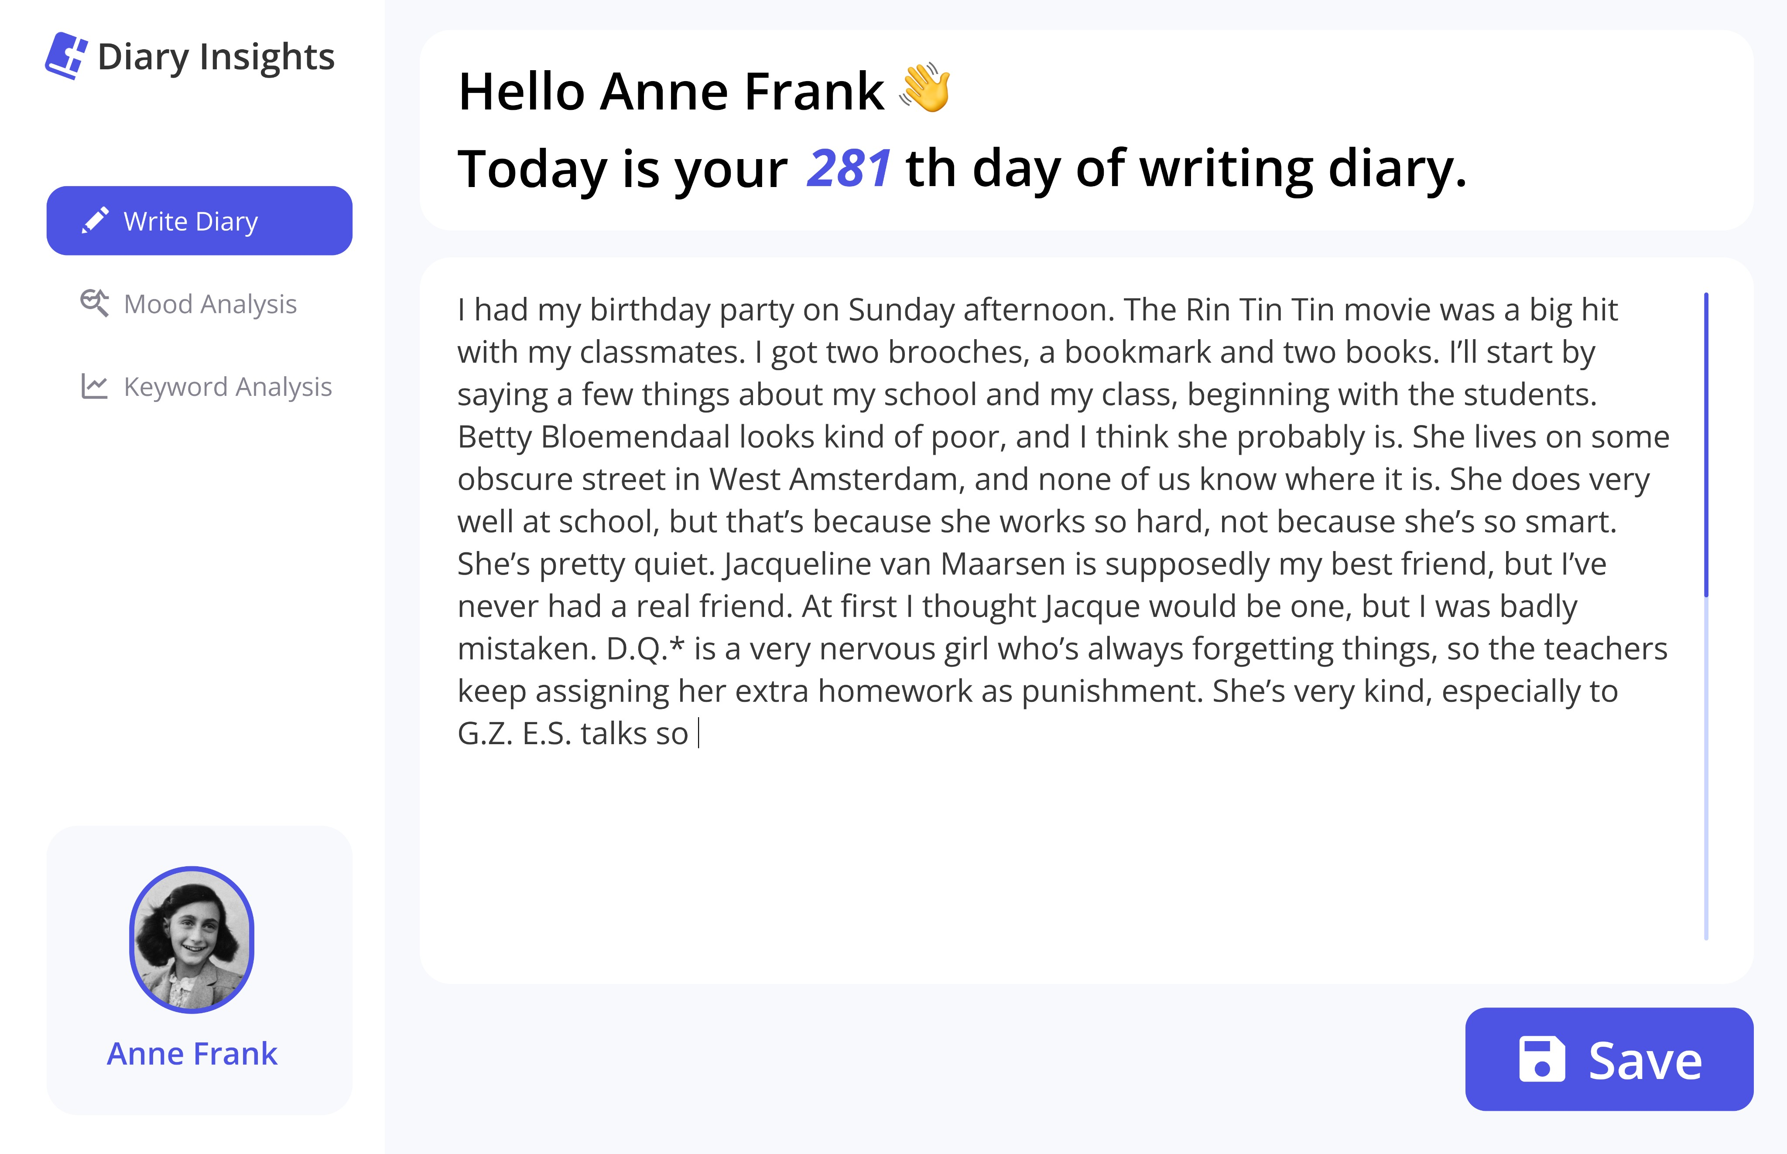
Notes:
Based on our protocol, we propose a novel system named Diary Insights, surpassing our objective of building an traditional NLP protocol of diary analysis based on the accumulated diary input the user has provided,

Slide 21

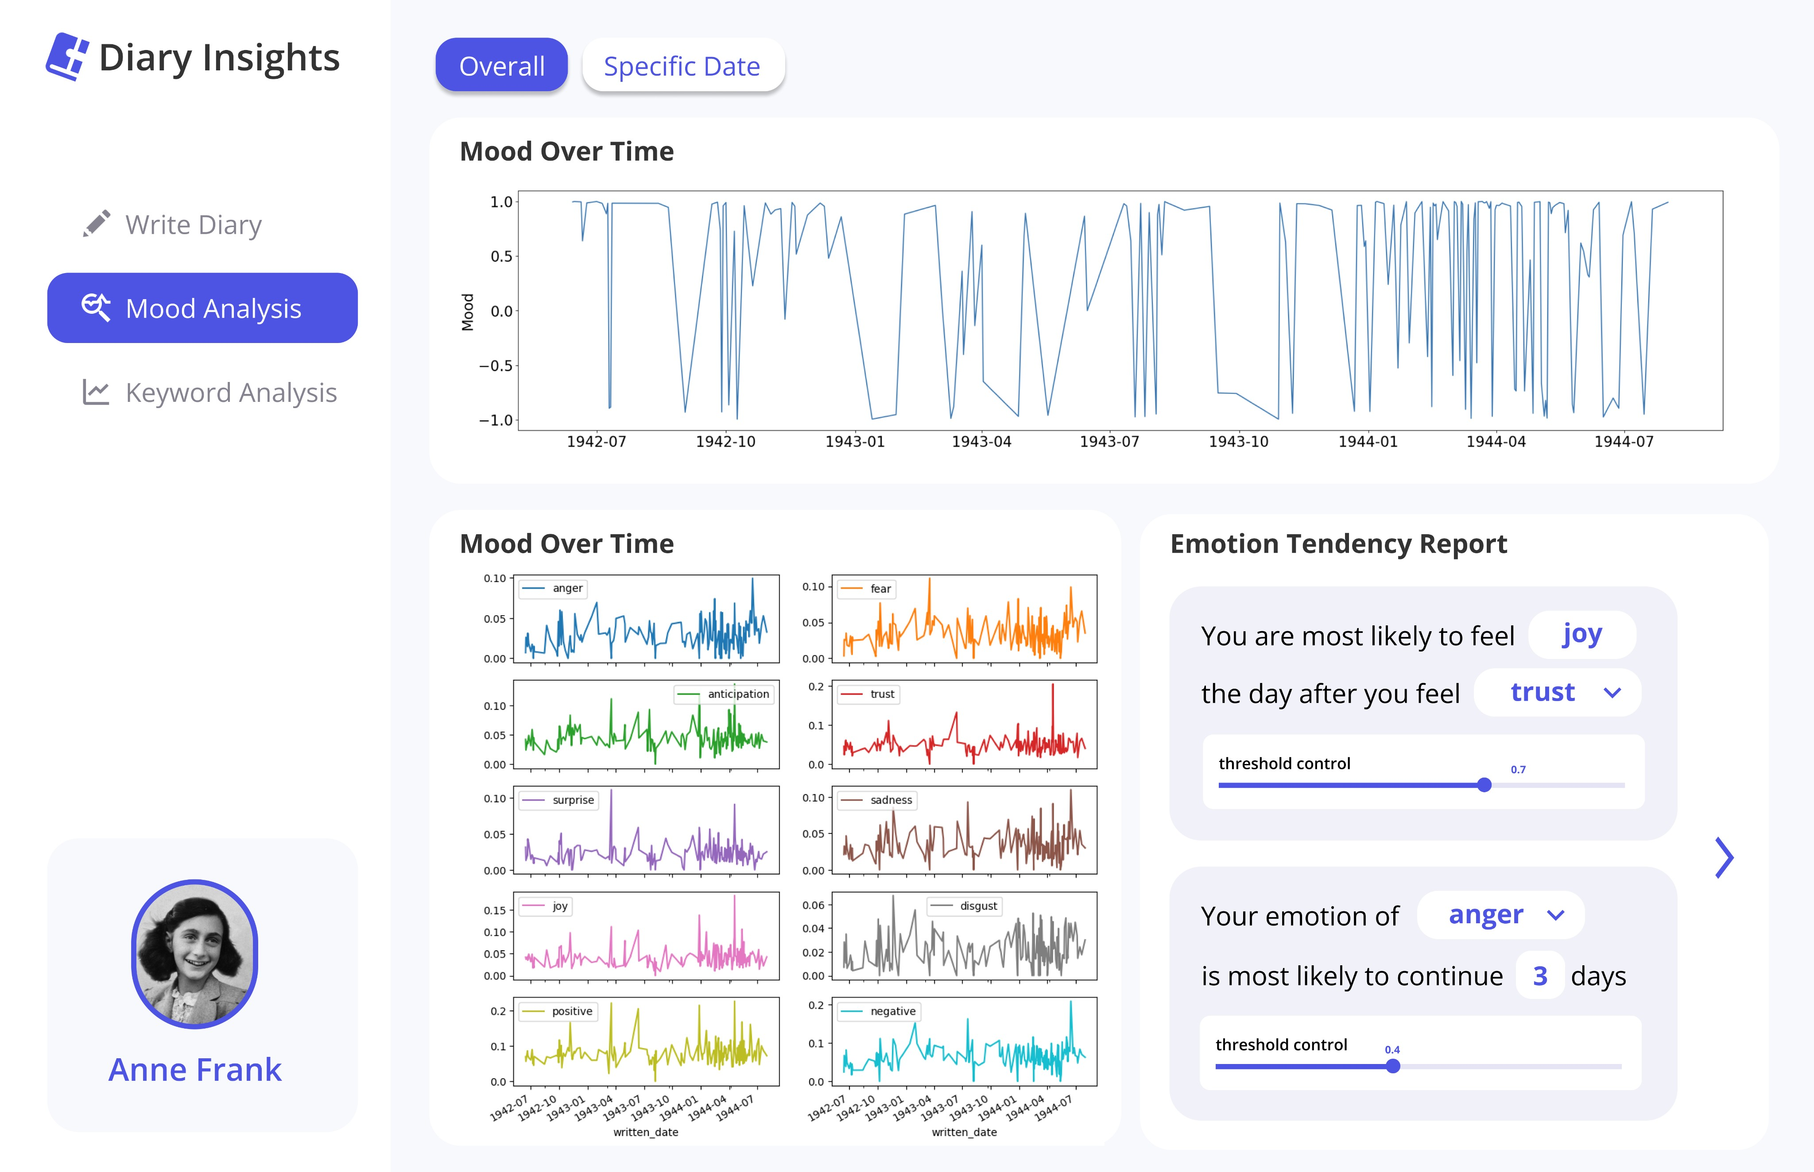
Notes:
Diary Insights provides analysis of one’s mood over time, and emotion tendency reports that we’ve mentioned earlier.

Slide 22
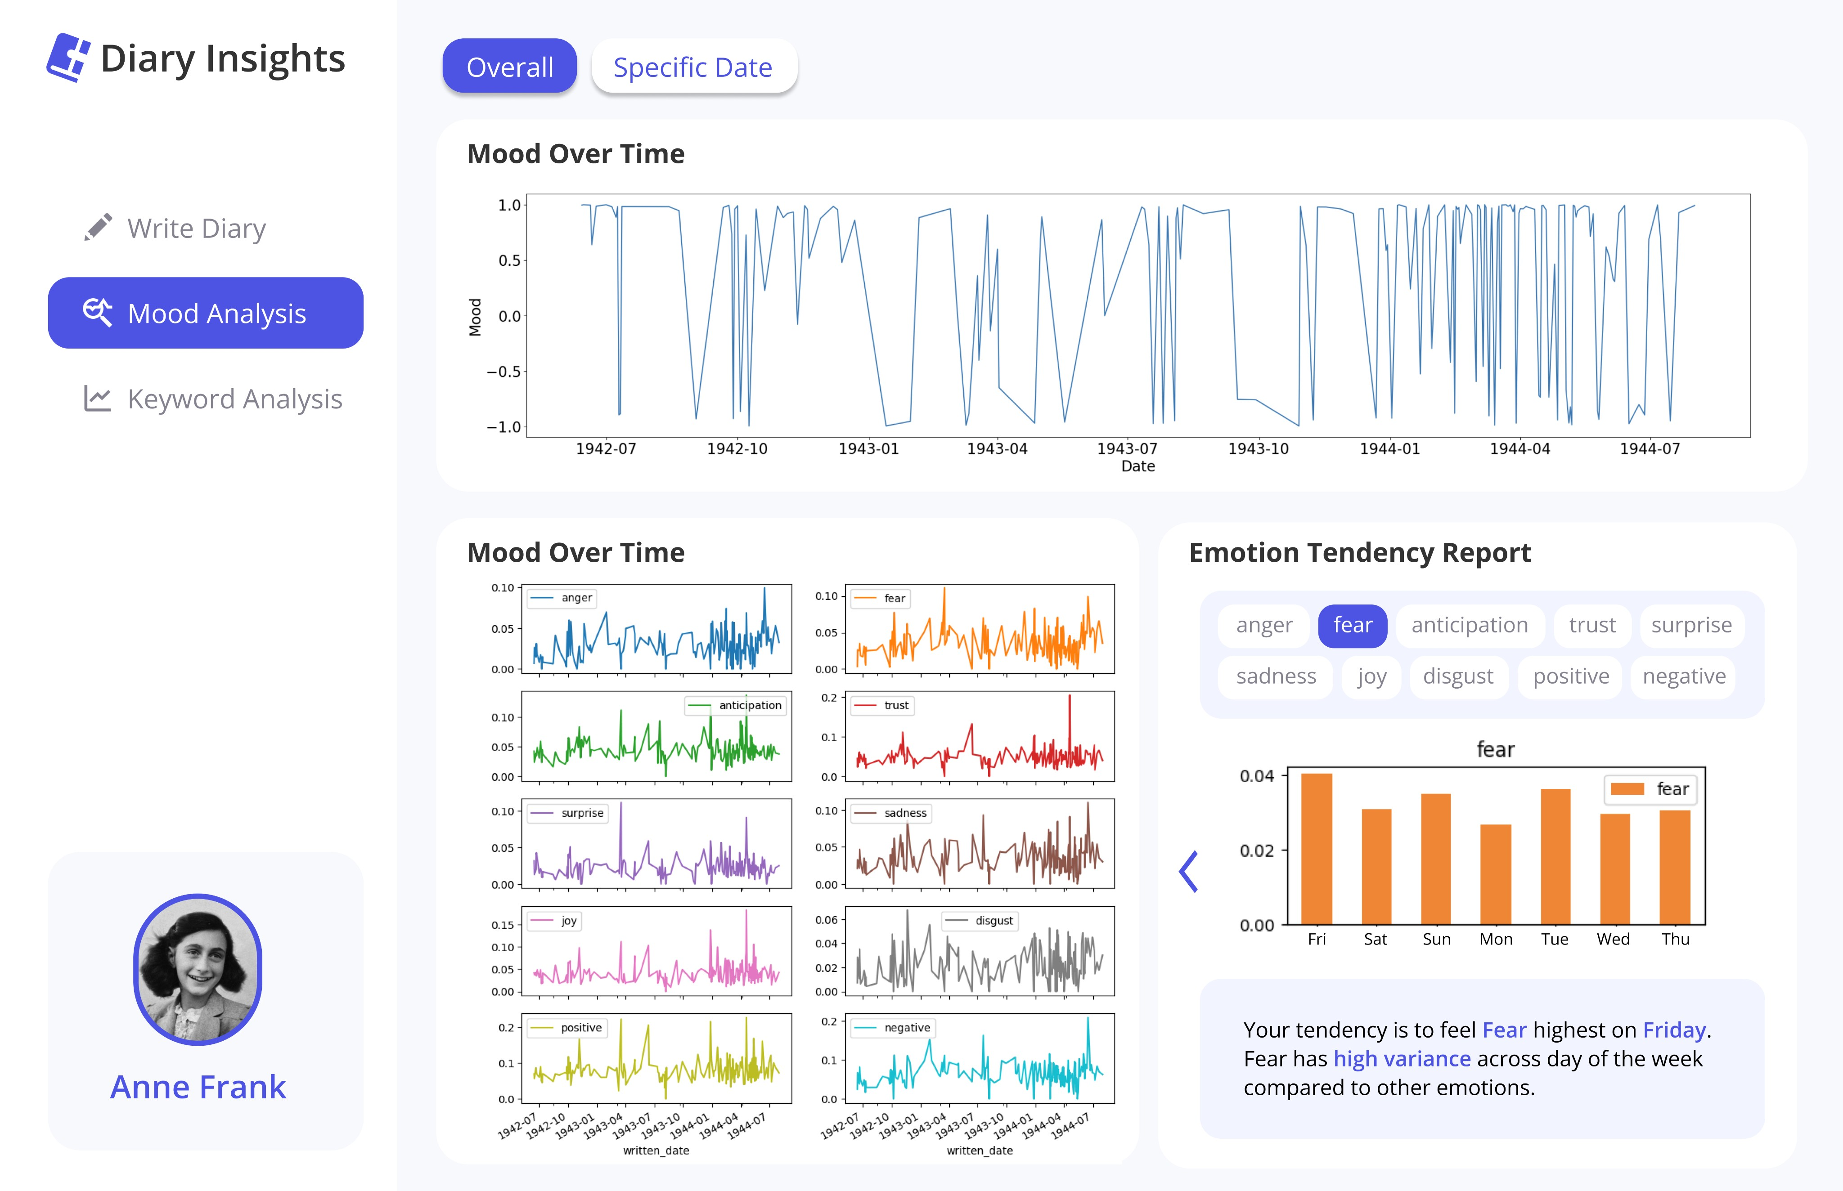
Notes:
It also provides insights in natural language.

Slide 23
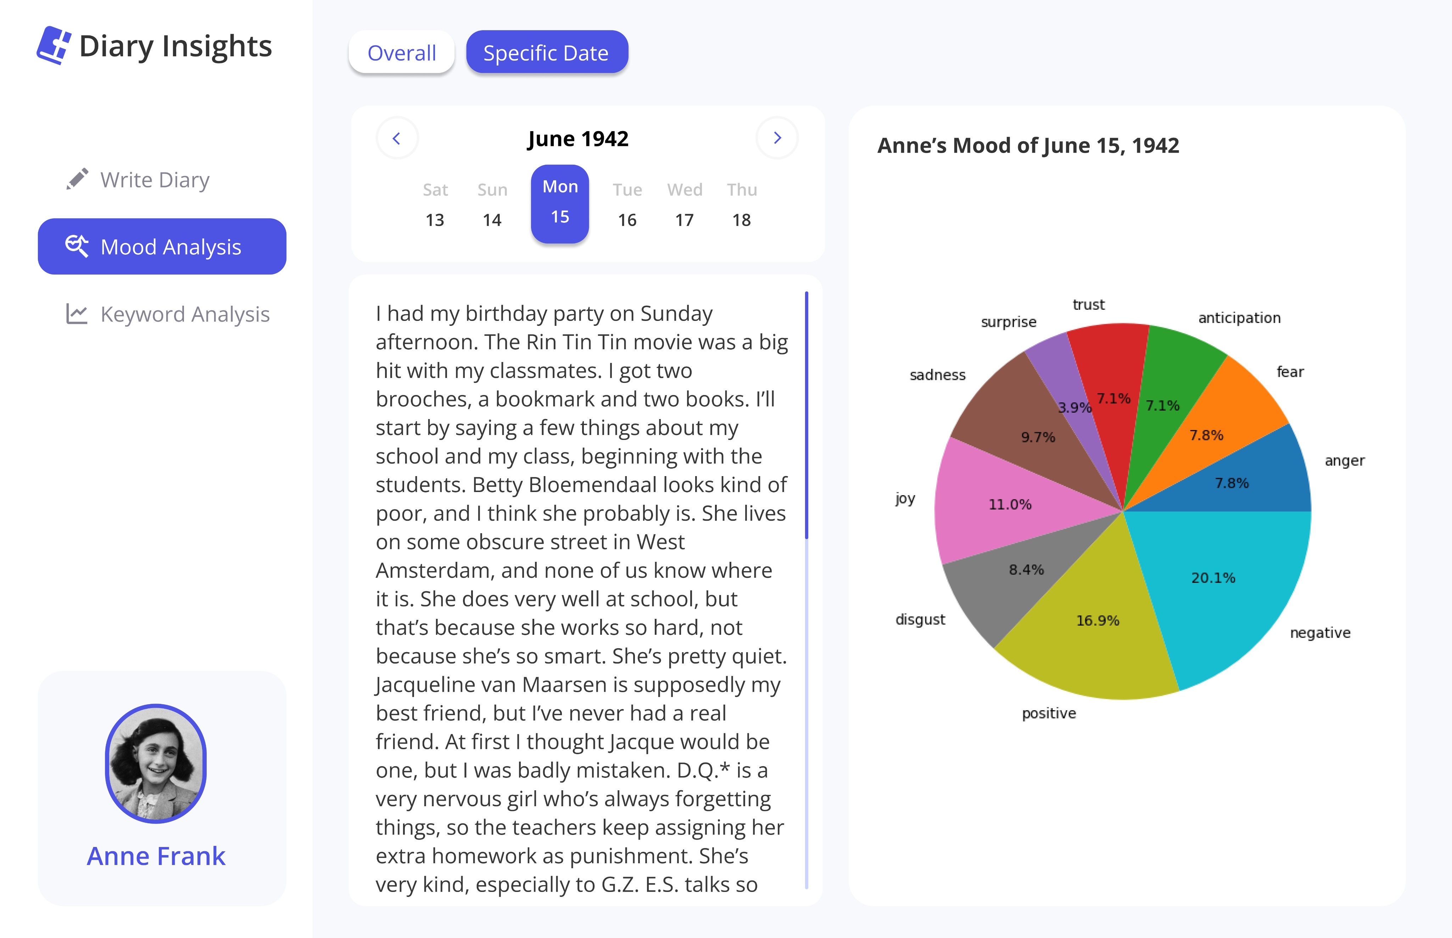
Notes:
Daily Analysis regarding mood and

Slide 24
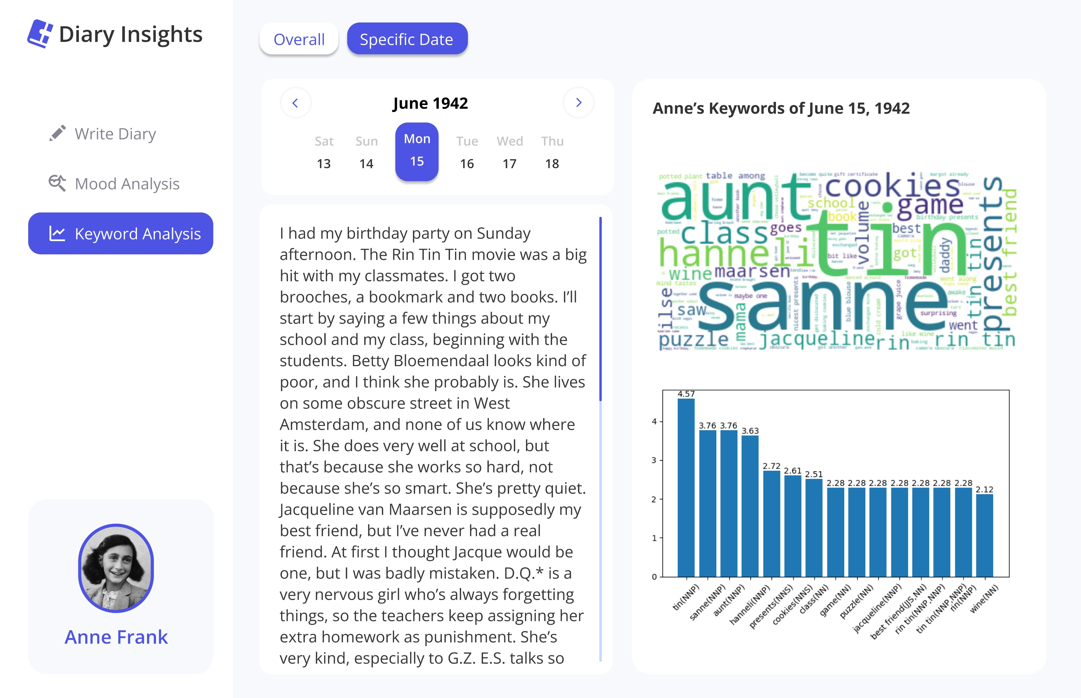
Notes:
keywords are also provided

Slide 25
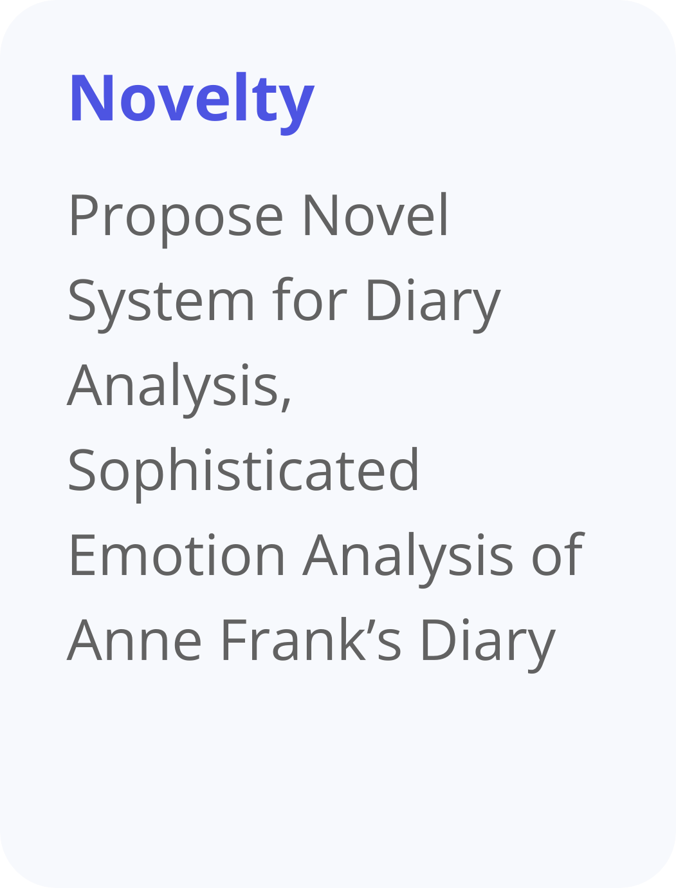
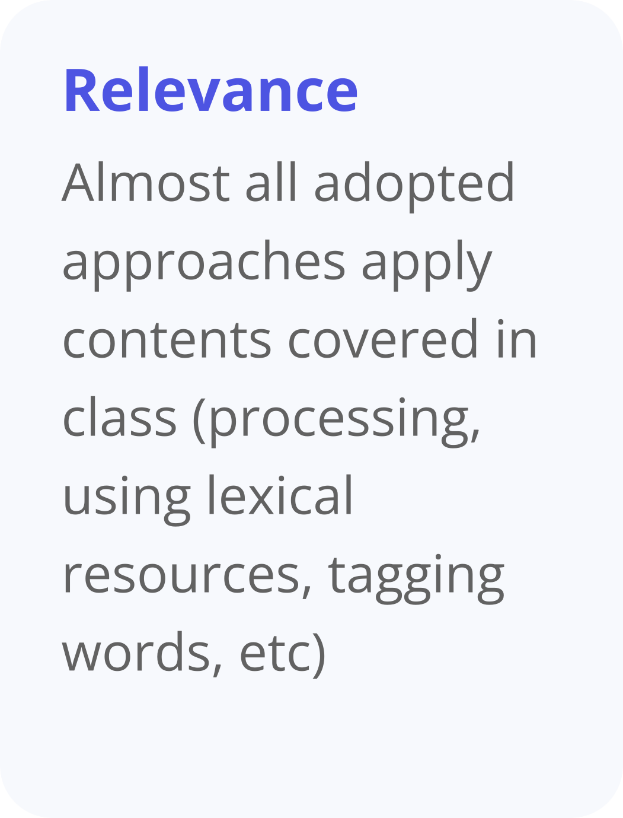
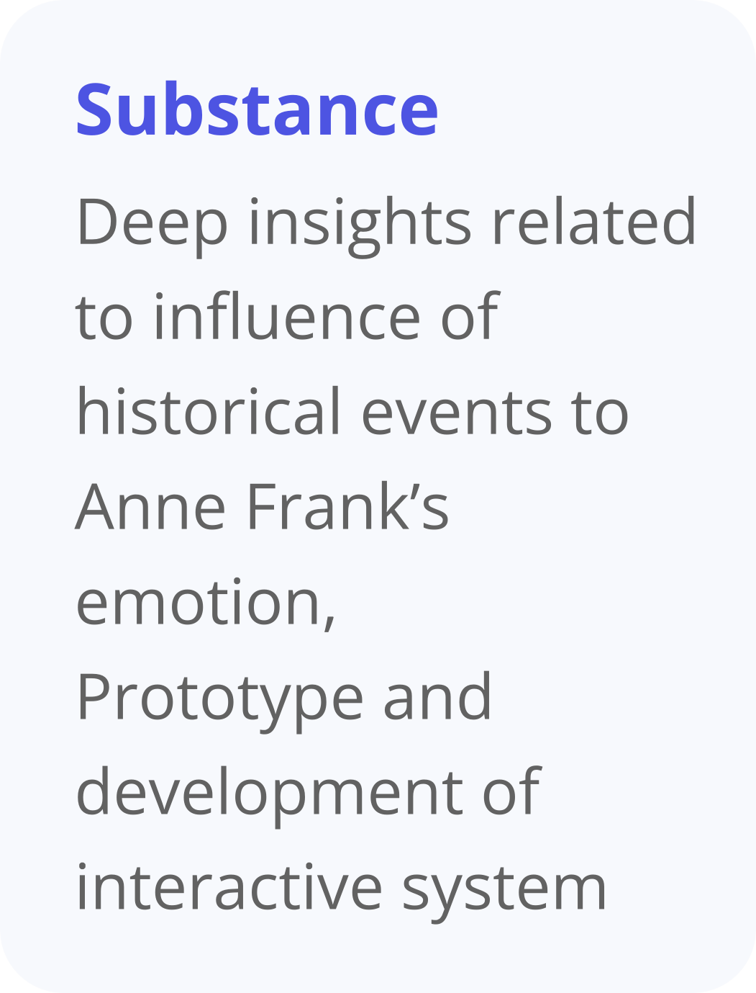
Notes:
Concluding our presentation, we’d like to argue the novelty, relevance, and substance of our project result as shown

Slide 26
Notes:
Actually, we did even much more than we have proposed in our proposal. Hence, we still have some limitations, so would like to propose some future works. For more accurate and abundant analysis, we will further combine more emotion lexicon, complement some interactiveness of the system, and also find more accurate formulas of TD-IDF

Slide 27
Notes:
Thank you for the attention

